Slide 1
Risk management
Generelle koncepter anvendt I flere hovedforløb

Slide 2
Relation til målepinde:
IT/CS H1: 1. Lærlingen kan redegøre for nøglebegreber indenfor informationssikkerhed og cybersikkerhed herunder privacy, databeskyttelse og trusselvektorer samt risikovurdering
IT/CS H3: 1. Lærlingen kan anvende proaktiv informations- og cybersikkerhed, med udgangspunkt i virksomhedens overordnede forretningsmål, igennem anvendelse af informationsteknologier (IT) og operationelle teknologier (OT) og under hensyn til virksomhedens størrelse og kompleksitet.
IT/CS H3: 2. Lærlingen kan udarbejde en risikovurdering på en mellemstor virksomheds aktiver og processer og implementere en CIS kontrol og mitigerings tiltag.
IT/CS H3: 4. Lærlingen kan anvende et governance, risk and compliance tool.
Notes:
https://eur-lex.europa.eu/eli/dir/2014/53/2024-12-28

Slide 3
Yderligere info/links:
https://www.ds.dk/da/download/guide-til-risikostyring-1 Introduktion til risikostyring for SMV’er
https://owasp.org/www-community/OWASP_Risk_Rating_Methodology - OWASP Risk Rating Methodology (simpelt værktøj, målrettet teknikere)
https://da.dbd.au.dk/c/blocks/teknisk -Arbejdsarkene fra kurset + en vejledning til hvordan de kan anvendes
https://virksomhedsguiden.dk/content/ydelser/it-risikovurderingsvaerktoej/fce38da7-025d-4326-98fe-c198f3ad8316/ - Risikoværktøj fra Virksomhedsguiden
https://virksomhedsguiden.dk/content/ydelser/systemoverblikket/5e7bb364-8440-40c6-8a2e-80802f685c2f/ - Systemoverblik fra Virksomhedsguiden
Sikkerdigital.dk Har generelt flere resourcer
Notes:
https://eur-lex.europa.eu/eli/dir/2014/53/2024-12-28

Slide 4
Agenda
Time | Topic | Format
8.30-10.00 | Introduction to risk management Why do risk management and what is it? The overall process | Presentation
10.00-10.15 | Break
10.15-11.00 | Context establishment (and introduction of case) | Workshop
11.00-12.00 | System modelling | Workshop
12.00-13.00 | Lunch break
13.00-13.30 | Asset Identification | Workshop
13.30-14.00 | Asset Analysis | Workshop
14.00-14.30 | Threat Identification | Workshop
14.30-14.45 | Break
14.45-15.15 | Threat Analysis | Workshop
15.15-15.45 | Risk Analysis, Evaluation and Handling | Workshop
15.45-16.00 | Digital tools and other alternatives | Presentation
16.00-16.30 | Closing remarks | Discussion

Slide 5
Introduction to risk assessment

Slide 6


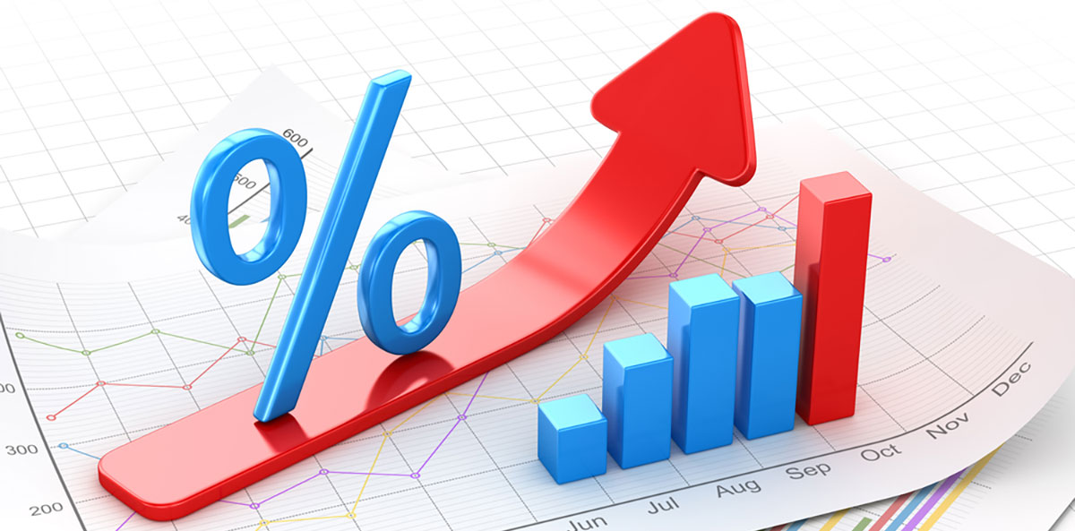
Everyone does risk assessment!
Notes:
Everybody does risk assessment, perhaps implicitly. Doing it explicitly, bring some advantages…

Slide 7
Formalized risk assessment has benefits
A prioritised TODO-list
Of things to protect
Of issues to handle
Something tangible to present to management
Sometimes regulatory mandated (NIS 2, GDPR, CRA)
A common understanding of security / a common language cross-company

Slide 8
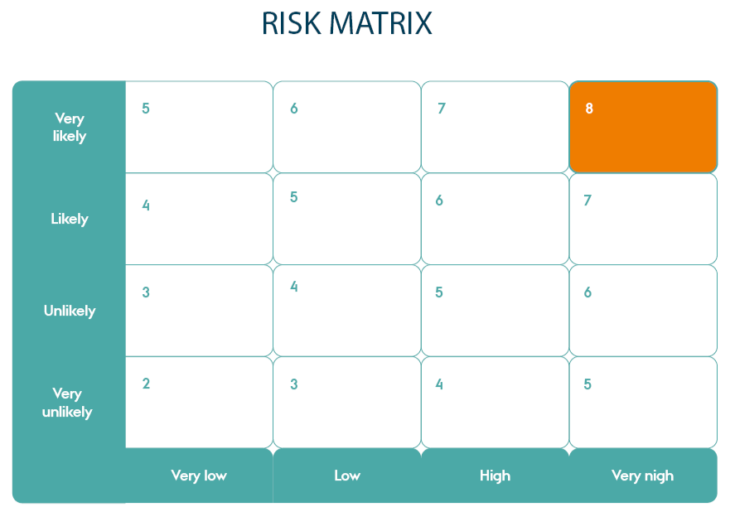
Risk: What and How
Risk = Likelihood x Consequence
OR
Risk = Likelihood x Consequence
Notes:
At the end of the day, any risk assessment method leads to compute risks as a function of likelihood, that is, probability for the threat to materialise, and consequence, that is, the impact of the threat
In this way, we can rank risks and make sure we focus on the most important risks first
Then, the next natural question is to wonder how to define and measure likelihood and consequences
Reasoning about the context can help define them for the specific case

Slide 9
Template of risk:
“Threat agent performs threat to achieve consequence”

Slide 10
Risk management (ISO 27005 inspired)
Context establishment
Risk assessment
Risk identification
System modelling
Asset identification
Threat identificaion
Threat modelling
Risk analysis
Risk evaluation
Risk treatment
Notes:
While ISO 27005 is our reference for Risk Assessment, in the slides we use this picture, where we bring focus to specific activities
Risk management process can be iterative
Risk assessment needs to be updated on a regular bases
Context establishment means assembling the internal and external context for risk management

Slide 11
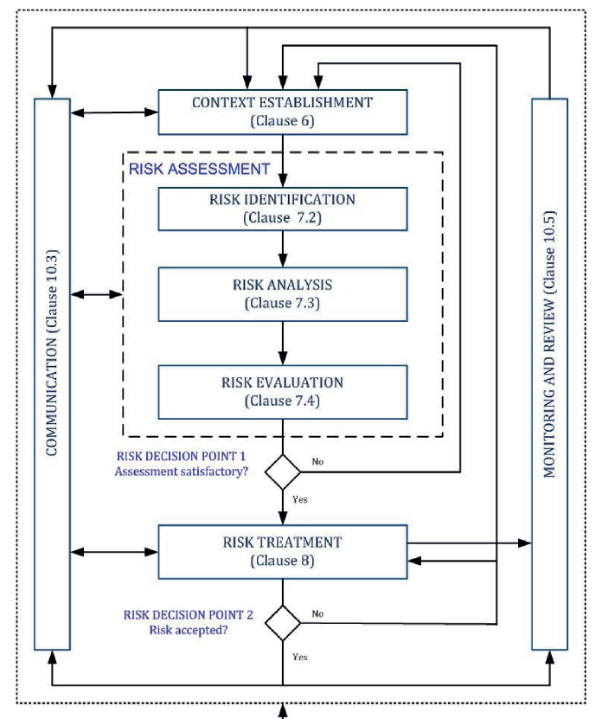
Risk management (ISO 27005)
Notes:
While ISO 27005 is our reference for Risk Assessment, in the slides we use this picture, where we bring focus to specific activities
Risk management process can be iterative
Risk assessment needs to be updated on a regular bases
Context establishment means assembling the internal and external context for risk management

Slide 12
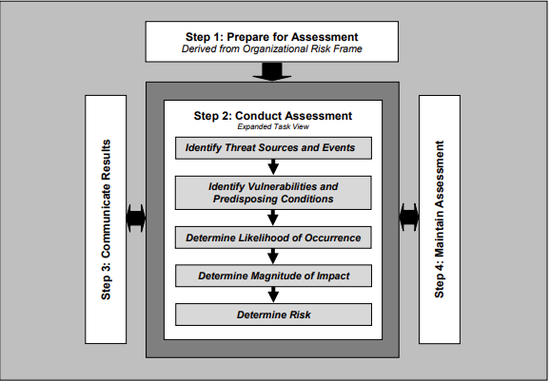
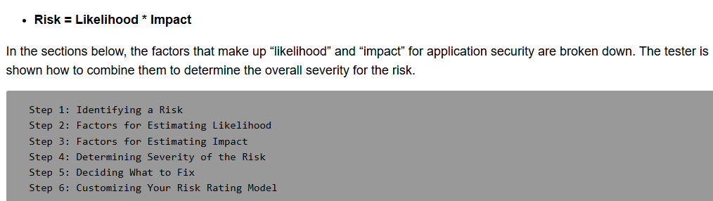
Risk management (other frameworks)
NIST SP800-30:
OWASP:
Notes:
While ISO 27005 is our reference for Risk Assessment, in the slides we use this picture, where we bring focus to specific activities
Risk management process can be iterative
Risk assessment needs to be updated on a regular bases
Context establishment means assembling the internal and external context for risk management

Slide 13

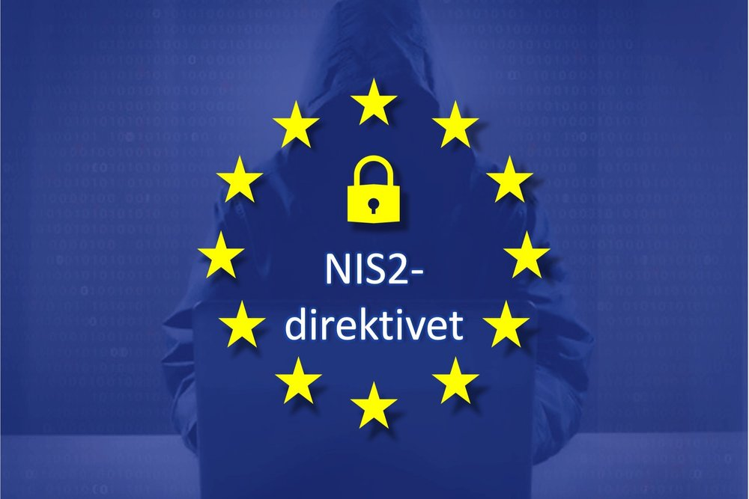

Establishing the Context
Why to do risk management?
Are there special consideration?
What can we tolerate?
Notes:
Legal compliance
Critical system

Slide 14
Risk – Likelihood
The agent (external)
Motivation
Skills
Teenager
Organised criminals
Enemy nations
Competitors
Mix
Strength of the system (Internal)
Security controls
Notes:
Likelihood – how likely it is that an attacker can exploit the threat

Slide 15
Risk – Consequence
Technical impact
Unauthorised access to data
Unauthorised access to function
Destroy something
…
Business impact
Loss of customers
Fines
Time and resources to clean up
…
C – Confidentiality
I – Integrity
A – Availability
Notes:
Consequence – what is the impact on the system if the threat to be exploit
Consequence criteria should be developed and specified in terms of the extent of damage or loss, or harm to an organization or individual resulting from the loss of confidentiality, integrity and availability of information.
It is essential to determine how many categories of consequences will be used, how they are defined, and what consequences are associated with each category.
Because consequences in different domains or departments of an organization can initially be expressed in various ways rather than strictly in monetary terms, it is useful if these various expressions can be cross-referenced to a common anchoring scale to allow approxim

Slide 16
Risk
Notes:
Risk appetite, defined as the amount of risk an organization is willing to pursue or accept, can vary considerably from organization to organization. For instance, factors affecting an organization’s risk appetite include size, complexity and sector. Risk appetite should be set and regularly reviewed by top management.

Slide 17
Template of risk:
“Threat agent performs threat to achieve consequence”

Slide 18
Risk assessment criteria
For both Likelihood and Consequence, we often use symbolic values for simplicity. In this workshop we will use:
Very low
Low
High
Very high
During context establishment, it is key to define what those labels mean
For instance:
Likelihood “very low” could be defined as probability 0,01% or frequency “every 100 years”
Consequences “high” could be defined as financial impact greater than 1MEUR or more than 20% customer base lost
Notes:
There are many ways of defining values for likelihood and consequence. As far as our workshop is concerned, we will use the following.
It is essential to determine how many categories of consequences will be used, how they are defined, and what consequences are associated with each category.
Because consequences in different domains or departments of an organization can initially be expressed in various ways rather than strictly in monetary terms, it is useful if these various expressions can be cross-referenced to a common anchoring scale to allow approximately equivalent levels of consequence in the different domains are correctly compared with each other.

Slide 19
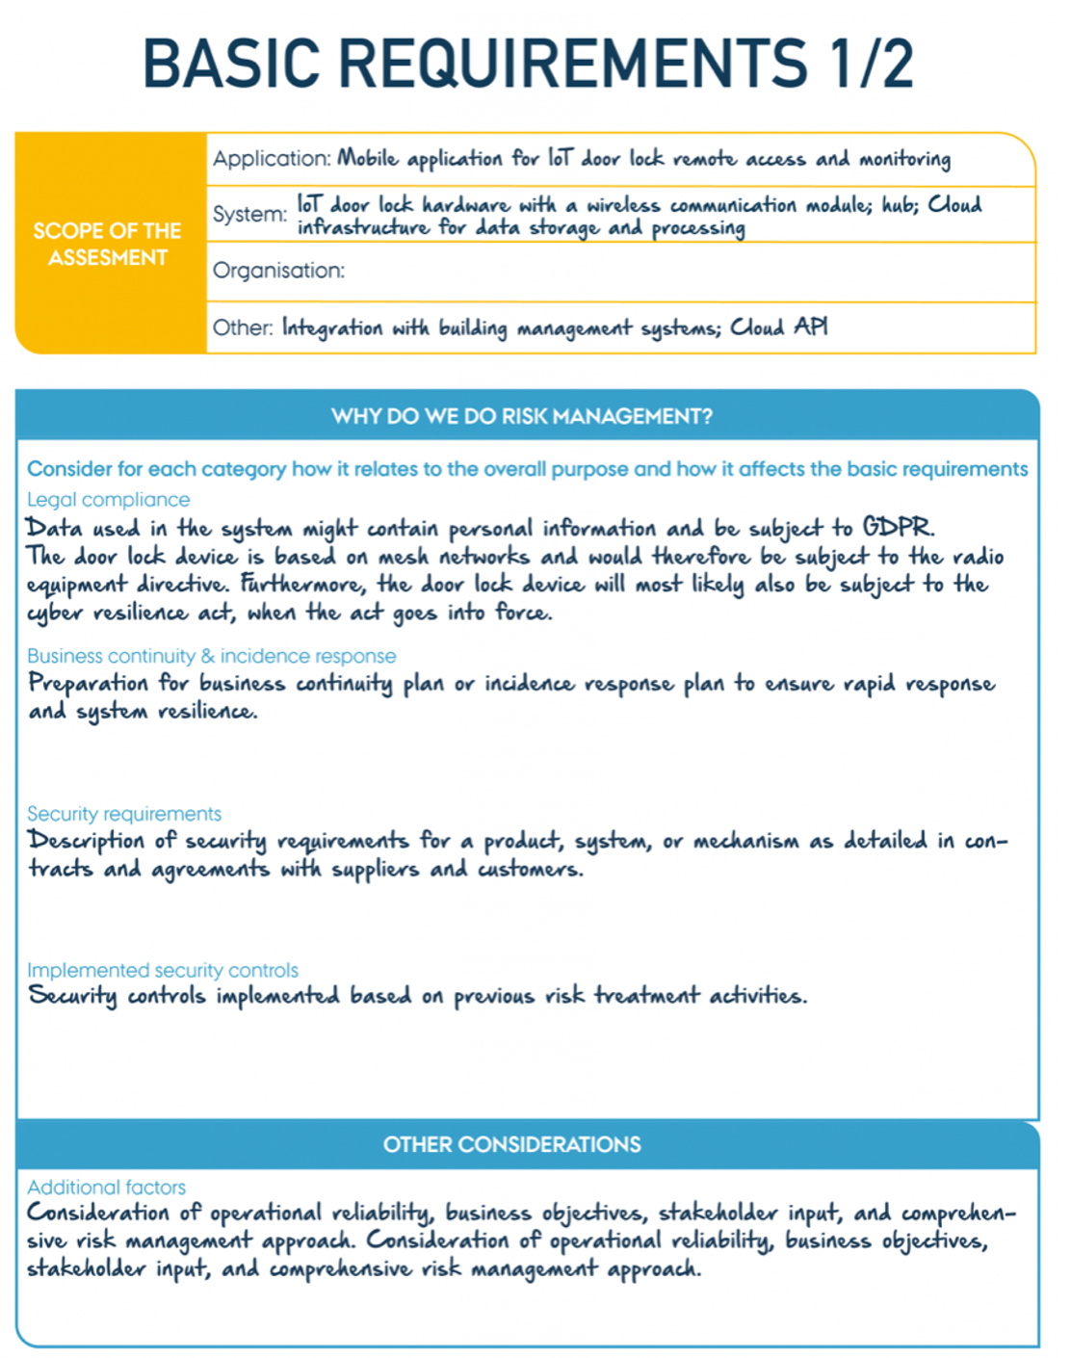
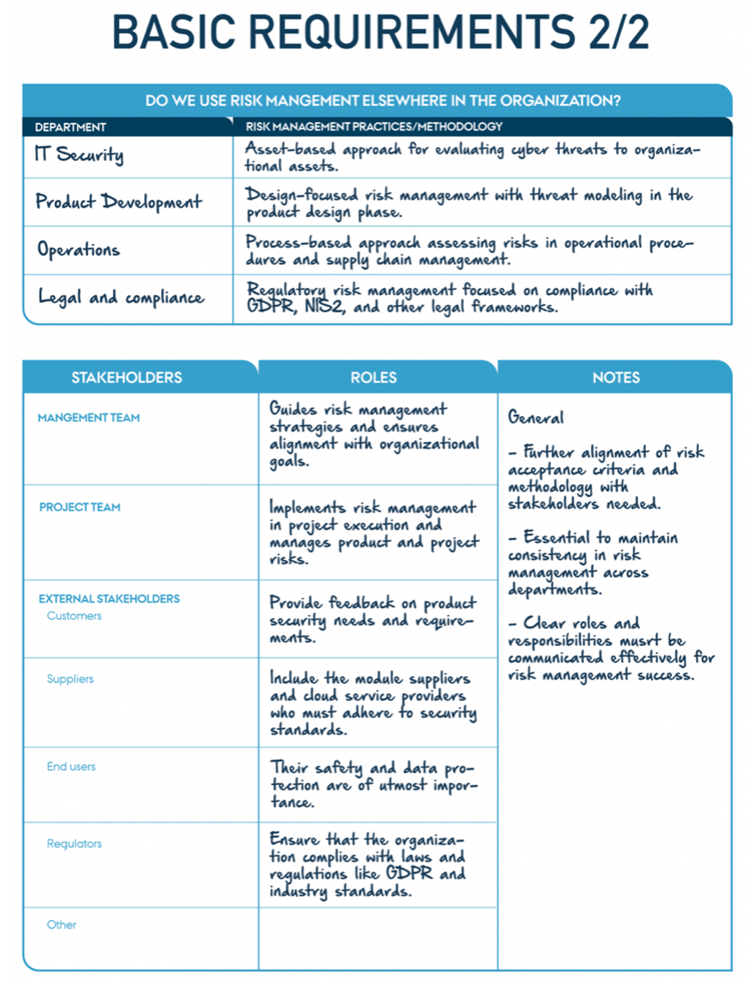
Context Establishment - Example

Slide 20
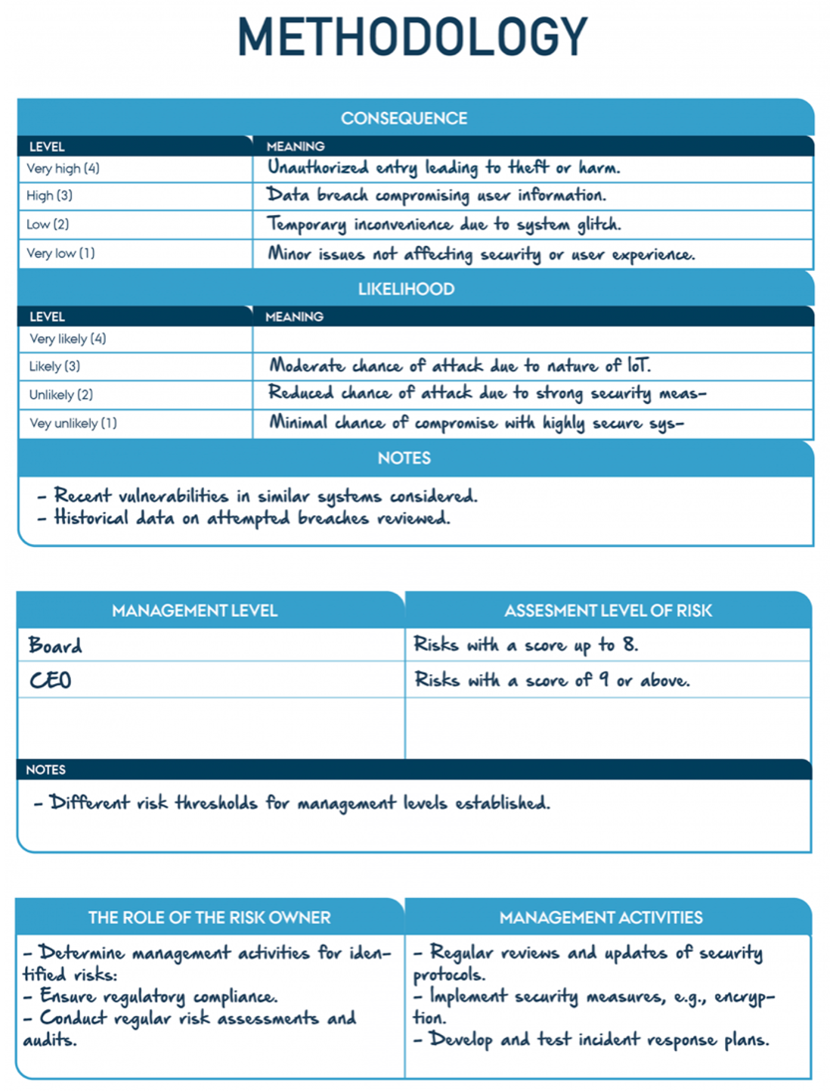
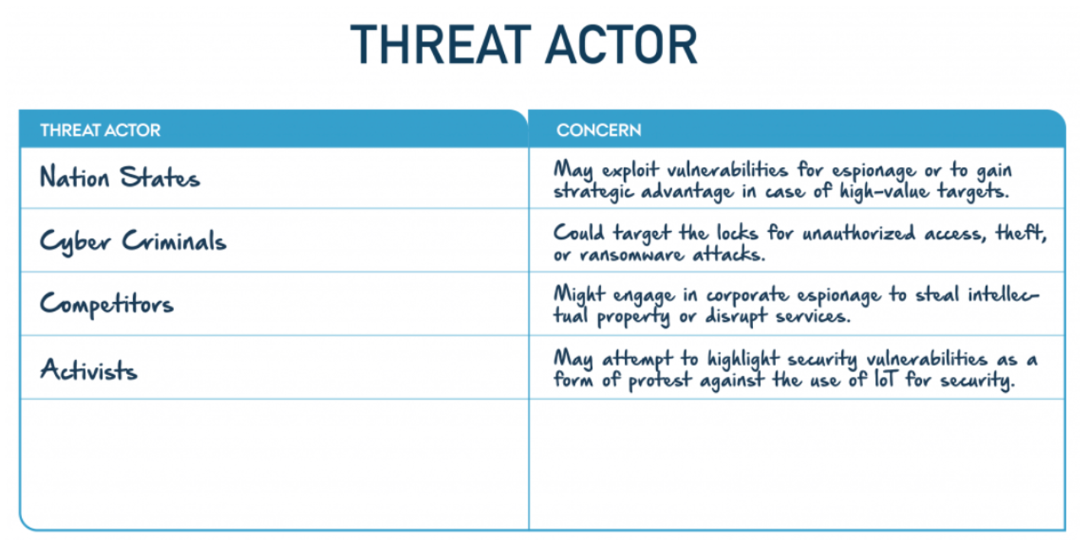
Context Establishment - Example

Slide 21
Risk management
Communication and consultation
Context establishment
Monitoring and review
Risk assessment
Risk identification
System modelling
Asset identification
Threat identificaion
Threat modelling
Risk analysis
Risk evaluation
Risk treatment
Notes:
While ISO 27005 is our reference for Risk Assessment, in the slides we use this picture, where we bring focus to specific activities

Slide 22
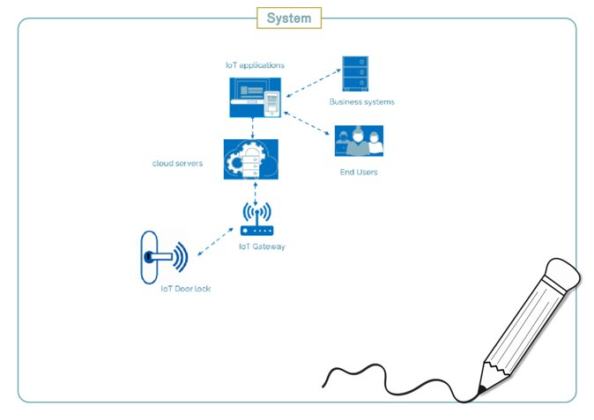
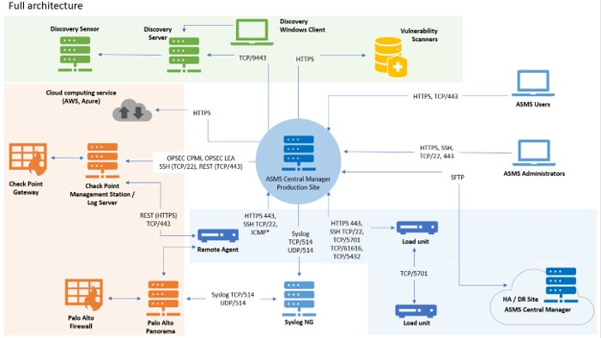
System Modelling
Overall goals:
Agree on what is being evaluated
Identify the “components” that form the system and their connections
Identify interactions between components
Understand how data flow across different components and data stores
Identify where a trust relationship between the components exists. Mark where the level of trust changes
What have we overlooked? Where does data come from and who uses data? How is the system managed? Backup and log systems?

Slide 23
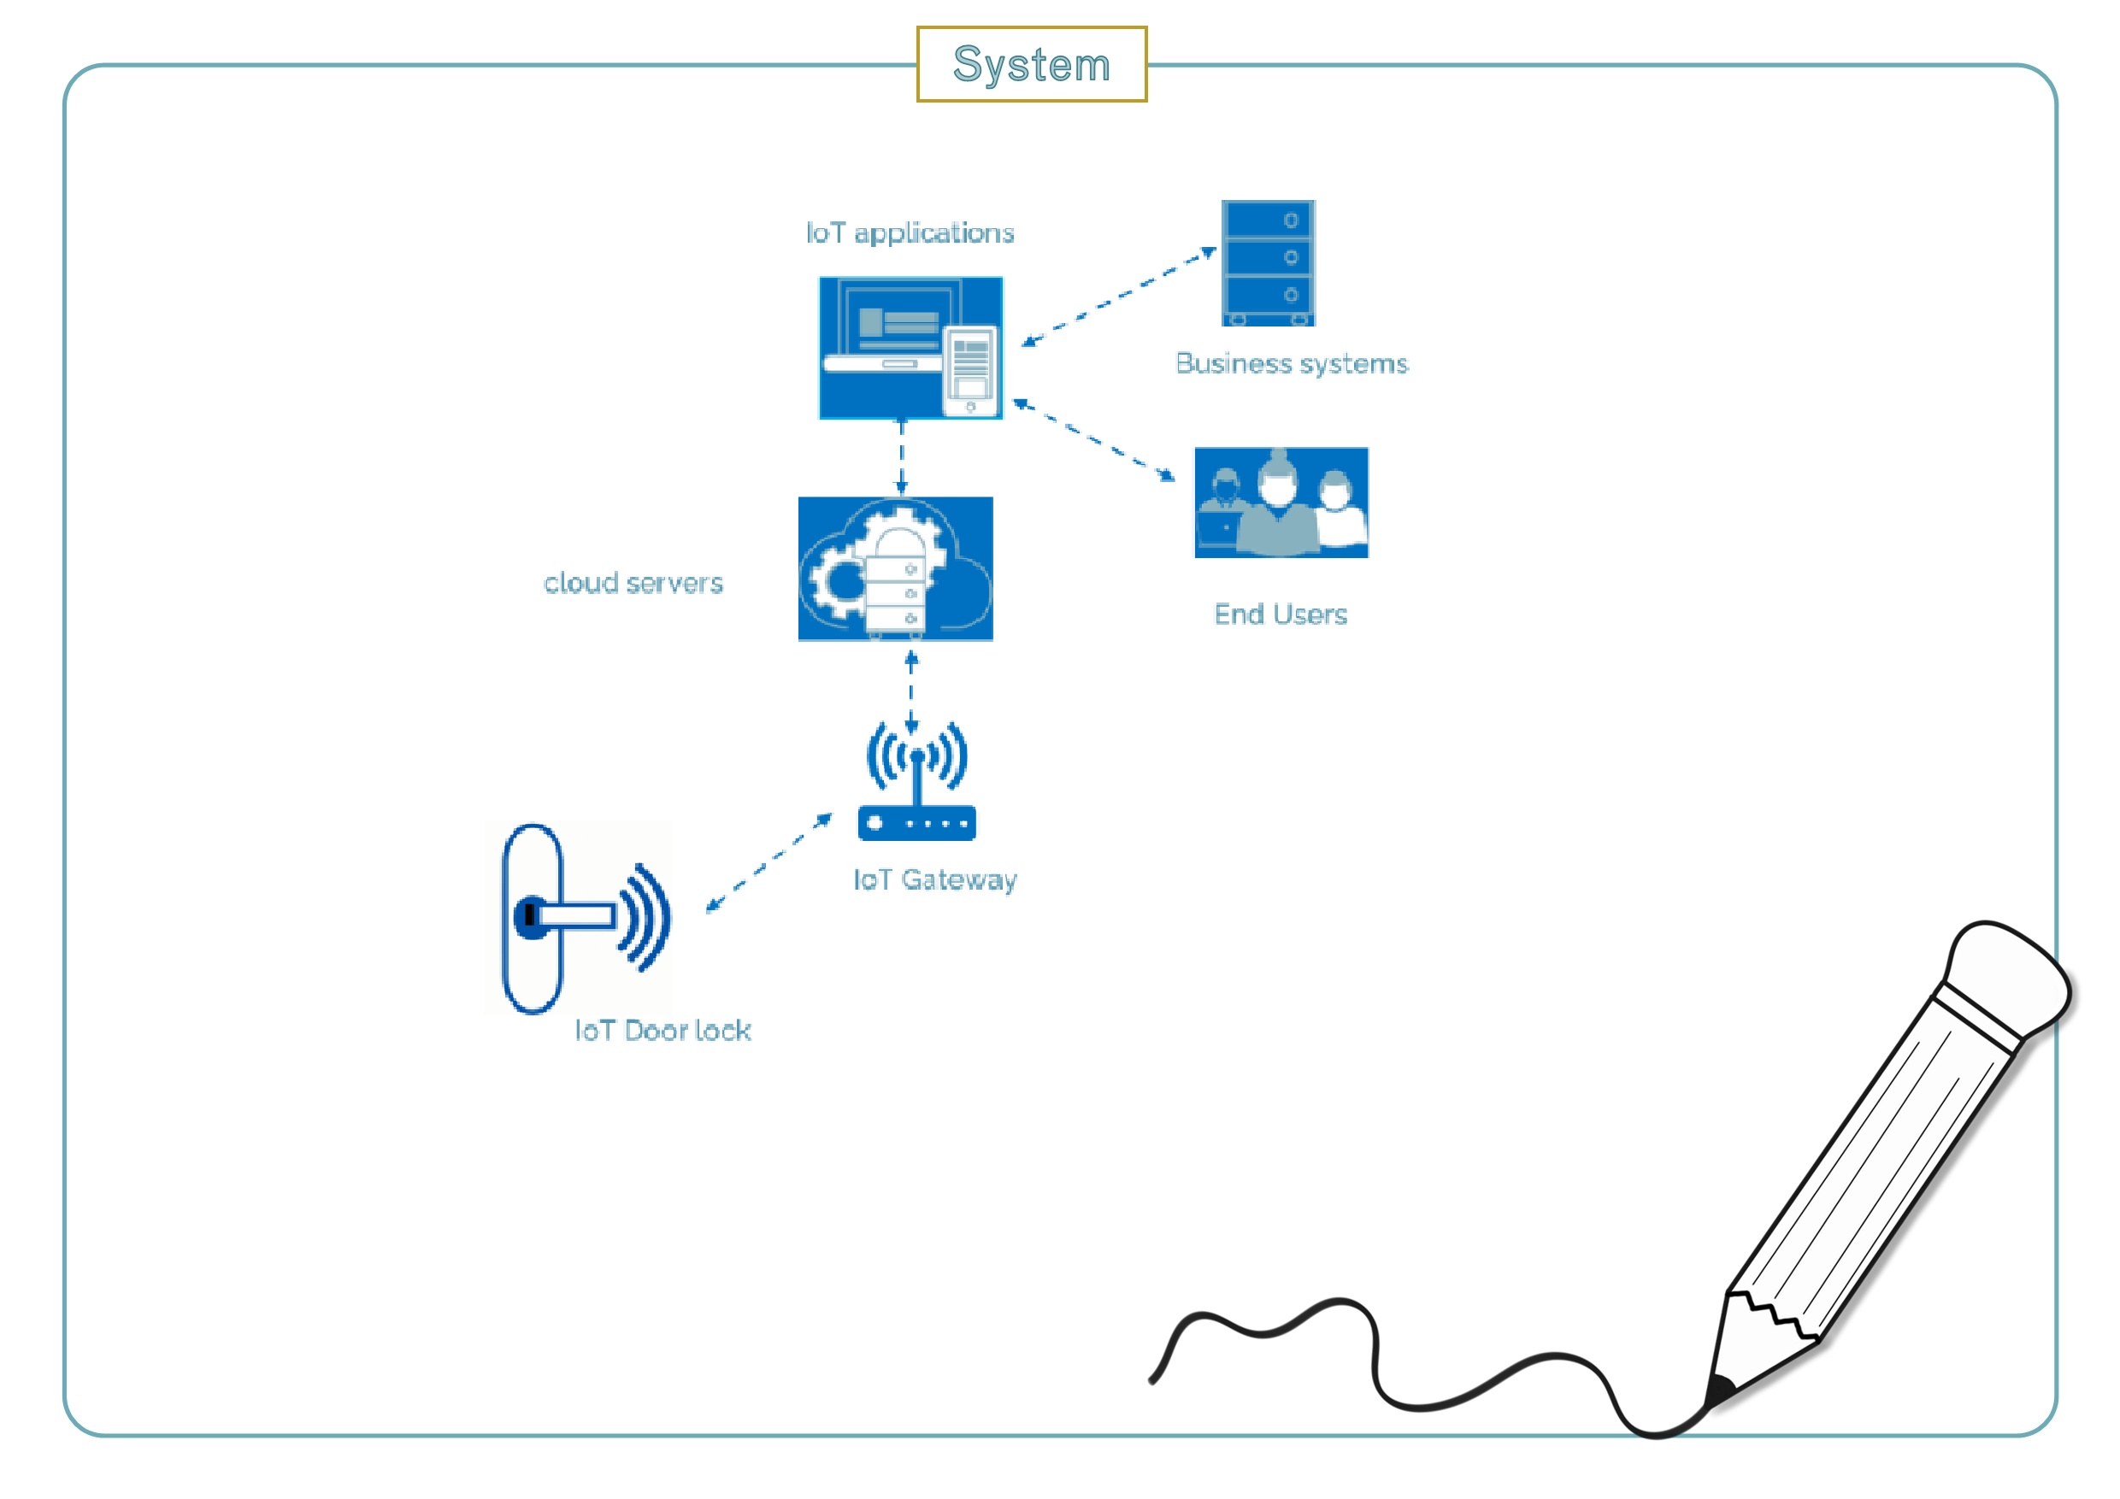
System Modelling - Example
IoT doorlock
An IoT device allows you to lock and open a door via a cloud solution
A smartphone app can be used to control the lock
Smartphone user is logged in to a cloud solution
Cloud solution is used for user management
API / Interface to other systems (related to user management)

Slide 24
Assets – What is it?
There are many definitions of “asset”
In general: an asset is anything that has value and is important to the organisation
This can be information, physical things and more
Focus on the protection of data/information (at least for today)
If there is important functionality, consider the asset as the data that facilitates the important functionality, etc.
Notes:
An asset is anything that has value to the organization and which, therefore, requires protection
Data – any information that is persisted or processed, e.g., customer information, source code
When working with risk management in general, "assets" can cover many things, from buildings and facilities to employees and knowledge. When working with risk management within IT and cyber security, it is useful to think of "assets" as data. This is primarily because the method we will subsequently describe for assessing the consequence of an incident is best suited for information/data and does not work so well for physical things. There may of course be physical things in the system that also need to be protected, for example if a sensor is expensive and can be stolen, but this will not be covered by this analysis. The above means that, for example, a server or a laptop is not an asset, while the data on the server is.

Slide 25
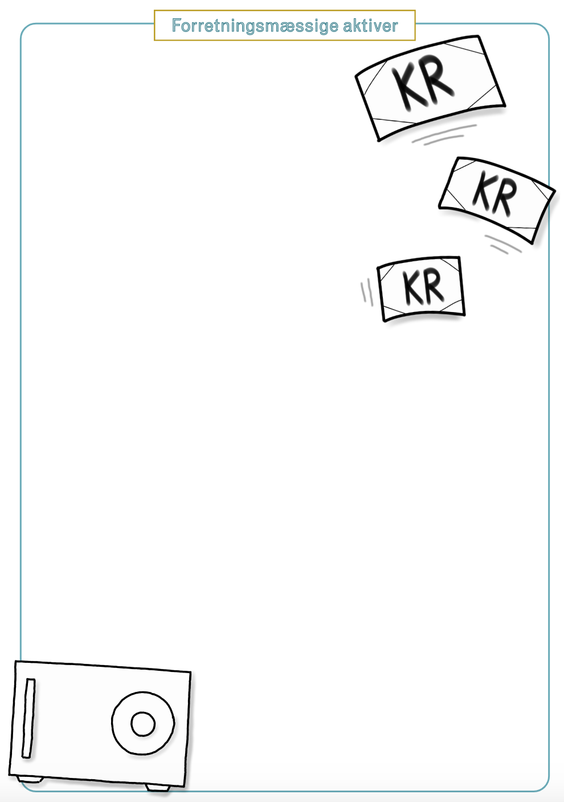
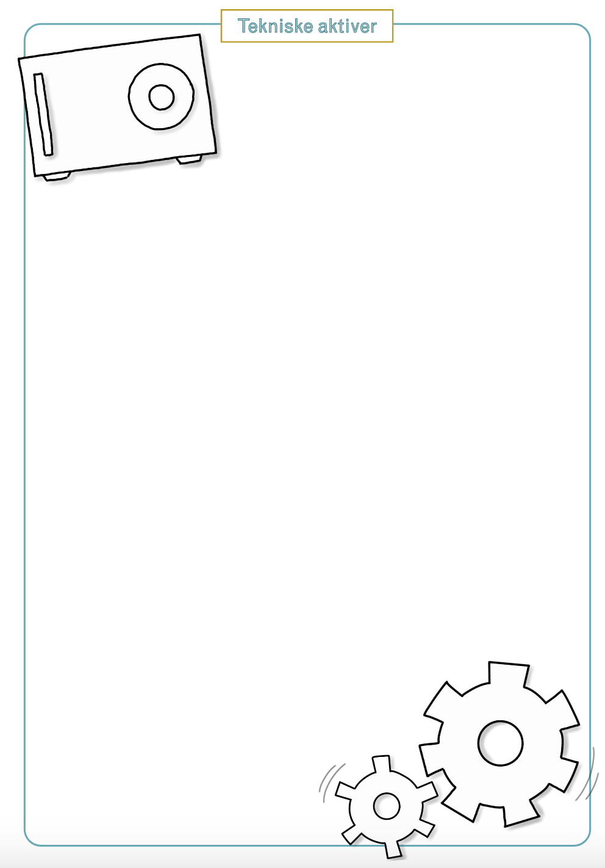
Asset Identification
Take the system architecture as the starting point
Brainstorm: think abstract and broad
List of business assets
List of technical assets
Combine the two lists
Keep the list abstract (but save the technical descriptions)
Identify data that are important to operate your system and/or business
Notes:
You can let people with business understanding describe what data it is that the customers and other stakeholders get/want, what it will be used for and what is needed to create it. At the same time, you can let technicians look at what data is in the system. This concerns what is stored in databases/file systems, data retrieved from external partners, data sent to clients, etc. The two lists can then be merged into a single list.

Slide 26
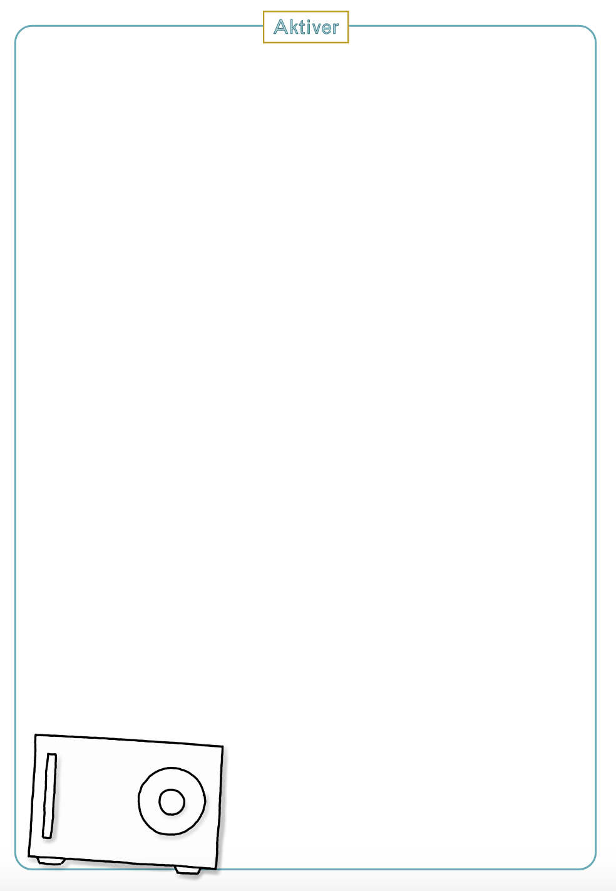
Asset Identification - Example
Assets:
Lock/unlock commands
Access credentials - users (passwords, keys)
Access credentials - systems
User data (including users access control list)
Log data
Notes:
Lock/unlock commands - Machine instruction for a door to (un)lock
Access credentials – user : Passwords and keys, controlling user access to the system
Access Credentials – systems: Key material for integrating with other systems
User data - Information on users, including the users access control list (ie. What doors may the user (un)lock)
Log data - Logs of when a user (un)locks a door + access to the system + change of access rights

Slide 27
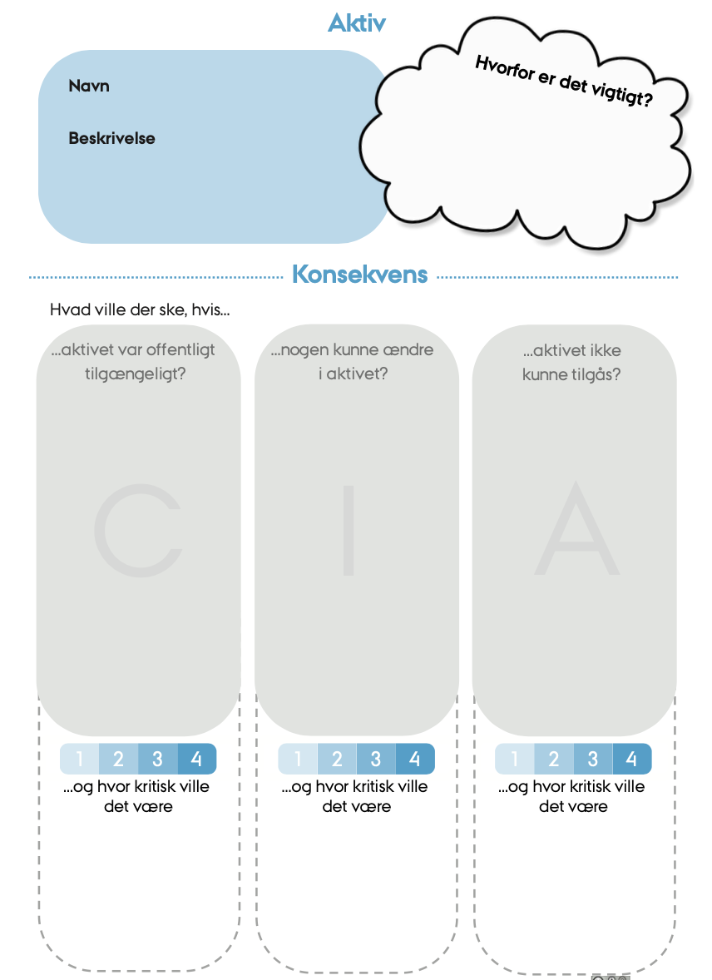
Asset Requirements
Overall goal: Assess how important the individual assets are (and why)
CIA
Confidentiality - data is kept confidential from unauthorized individuals
Integrity – data can only be modified by authorized individuals
Availability – data is available when needed
Asset requirements have a direct correlation to assessing threats on the asset itself
Notes:
Confidentiality - Should data be kept secret?
Integrity - What are the consequences of incorrect data?
Availability - Should data be available? How long can data be unavailable?

Slide 28
How to evaluate
Try to be as objective as possible
Can you put a concrete number on the cost, the fine, the loss?
Loss of reputation/potential customers might be difficult to estimate
Should external stakeholders be considered?
GDPR requires it, if it is personal data
NIS-2 considers supply chain security, consequences for society
CRA – Inherent risk classes?
What is the worst-case scenario and how realistic it is?
Should you consider scalability?
Notes:
NIS-2 - Organisations subject to the NIS2 Directive are liable for their supply or supplier chains. In a NIS2 context, this means that organisations must not only protect their own networks and systems, but they must also consider the security of the products and services they purchase from third parties.

Slide 29
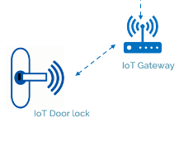
Asset Requirements – Example: Lock/unlock commands
Description: The command that causes the lock to lock or unlock. Send from the cloud solution, via IoT gateway to the lock.
CIA:
Confidentiality – Data can be used to conclude when a person is at home/left the building (in consumer market) (Score: 3)
Integrity – If data can be manipulated, the function of the lock can be affected (Score: 4)
Availability – If the commands can be blocked, the lock will not work (Score: 4)

Slide 30
Break

Slide 31
Risk management
Communication and consultation
Context establishment
Monitoring and review
Risk assessment
Risk identification
System modelling
Asset identification
Threat identificaion
Threat modelling
Risk analysis
Risk evaluation
Risk treatment
Notes:
While ISO 27005 is our reference for Risk Assessment, in the slides we use this picture, where we bring focus to specific activities

Slide 32
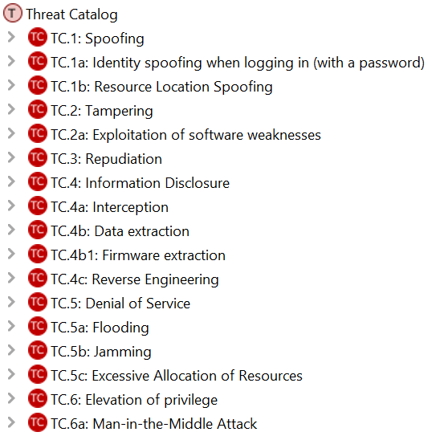
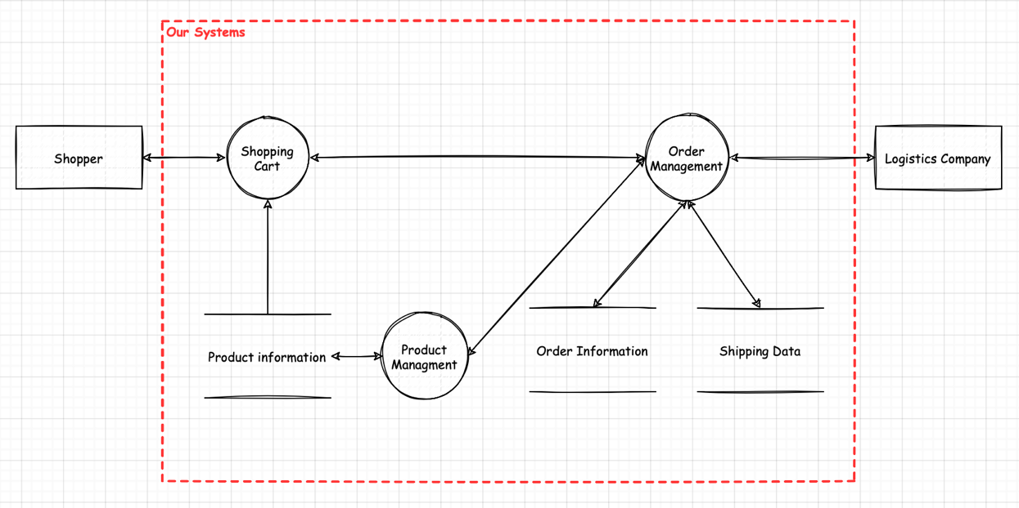
Threat identification
Think about what can go wrong with the system’s security
What threats are there?
Notes:
Threat identification - Thinking about what can go wrong with the system’s security

Slide 33
Approach 1: Threat catalogues
Pros:
Easy to do – just follow the list
You won’t forget a threat
Easy to communicate externally
Cons:
Finding a suitable catalogue can be challenging
Either too general or too specific
Either too many or too few threats
Notes:
Good thing: In general IT, good threat catalogues are more prevalent

Slide 34
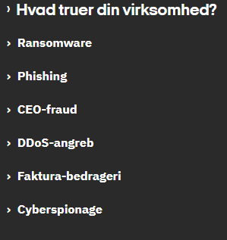
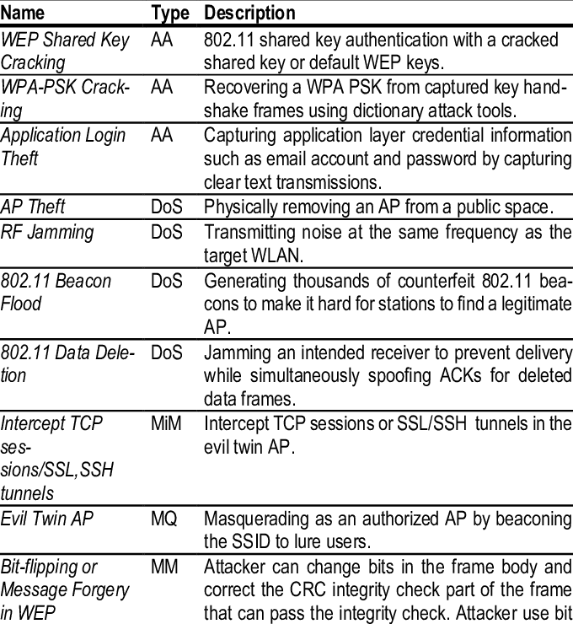
Approach 1: Threat catalogues

Slide 35
Approach 1: Threat catalogues
Some suggestions:
https://attack.mitre.org/
https://www.sikkerdigital.dk/virksomhed

Slide 36
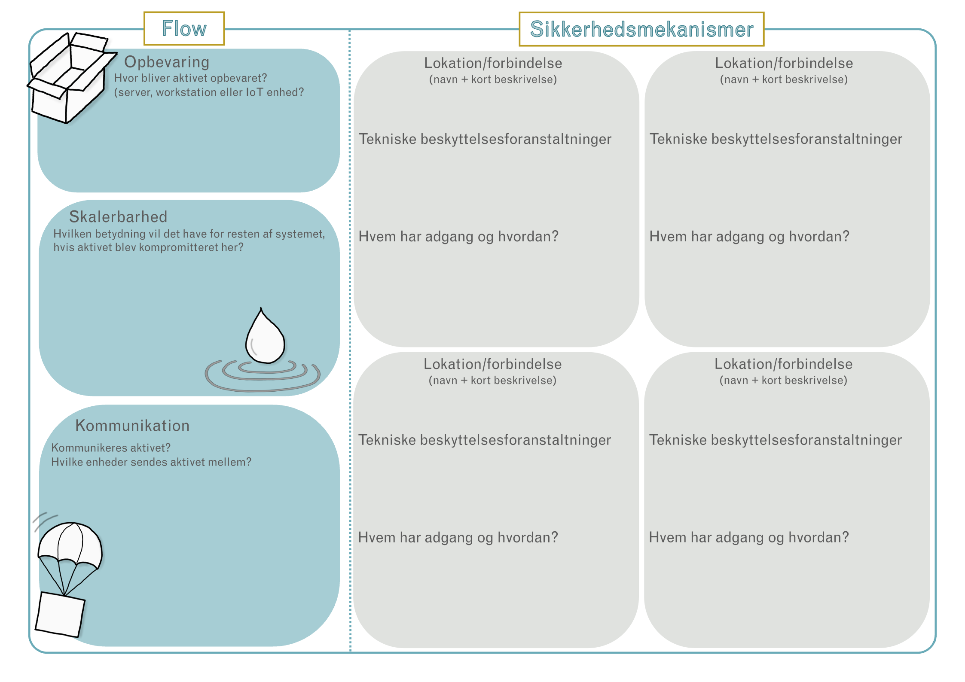
Approach 2: Flows and security
Overall goal: Assess the security for the asset
Describe where and how the asset can be accessed
How are those locations / mechanisms protected
Technically
Organisationally

Slide 37
Approach 2: Start by where....
Where is the asset stored
On the IoT devicet?
On the backend?
On the client?
Printet/physically?
Scalability – Is the same amount of data stored everywhere?
Where is the asset communicated?
Which components communicate?
Refer to the system architecture / drawing from earlier
Does these descriptions match the architecture?
Access-credentials for system integration from the example
Where is the asset stored?:
On the cloud backend
(On administrators laptop during configuration)
Where is the asset communicated?
Sent between cloud backend and integrated systems

Slide 38
Approach 2: … Then how
Expertise from technicians can be necessary
Is communication encrypted and (mutually) authenticated?
How? How is key material handled?
How is data-at-rest protected?
Encryption? Access control lists?
How is the organisational security?
Who determines who should have access?
Is the administrator supervised?
Is there protection from employees/insiders?
Malicious or accidental?
System integration access credentials
TLS connection
Server is authentificated using X509 (i.e. normal CA-chain) before credential is used
Credentials/Keys are stored encrypted on backend
...

Slide 39
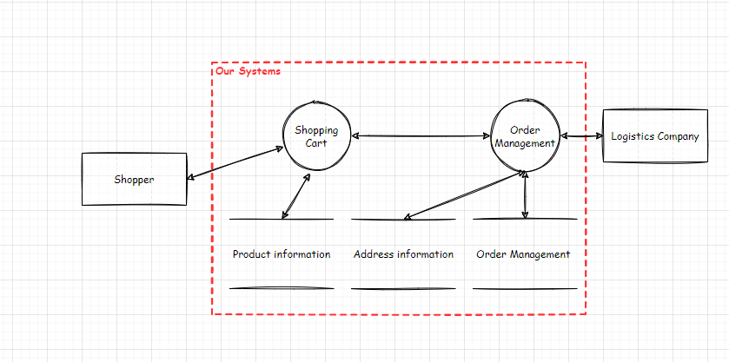
Tilgang 3: Threat modelling

Slide 40
Threat identification
Consider what can go wrong in the system security
Identify potential threats
Data flows crossing “trust boundaries”
Threats when different “trust levels” interact
Data flows inside “trust boundary”
Insider threats in the system

Slide 41
System Model – Example
The system involved in ordering from a webshop, including the interaction between the customer and the logistic provider

Slide 42
Threat Identification – Example
Data flows across trust boundary: Shopper to shopping cart

Slide 43
Threat Identification
CIA triad
Confidentiality – data protected from unauthorised access
Can the access control mechanisms be bypassed?
Integrity – data accurate and consistent
Can malformed data be entered into the system?
Availability – data accessible and usable on authorised demand
Can a 3rd party issue affect your own availability?

Slide 44
Threat identification – Example

Slide 45
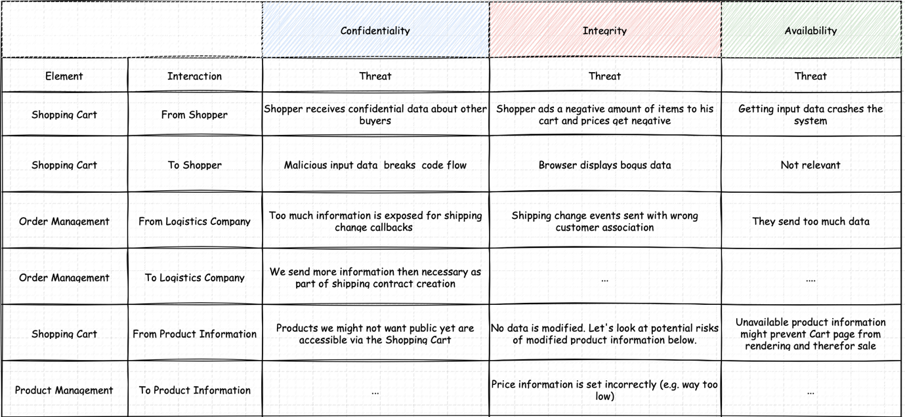
Threat Identification – Example

Slide 46
Threat Identification
STRIDE
Spoofing – Pretending to be someone else
Tampering – Modifying something (you’re not allowed to)
Repudiation – Denying you did something
Information disclosure – Obtaining (secret) information
Denial of Service – Preventing a service
Escalation of privilege – Bypassing authorization

Slide 47
Threat identification – STRIDE

Slide 48
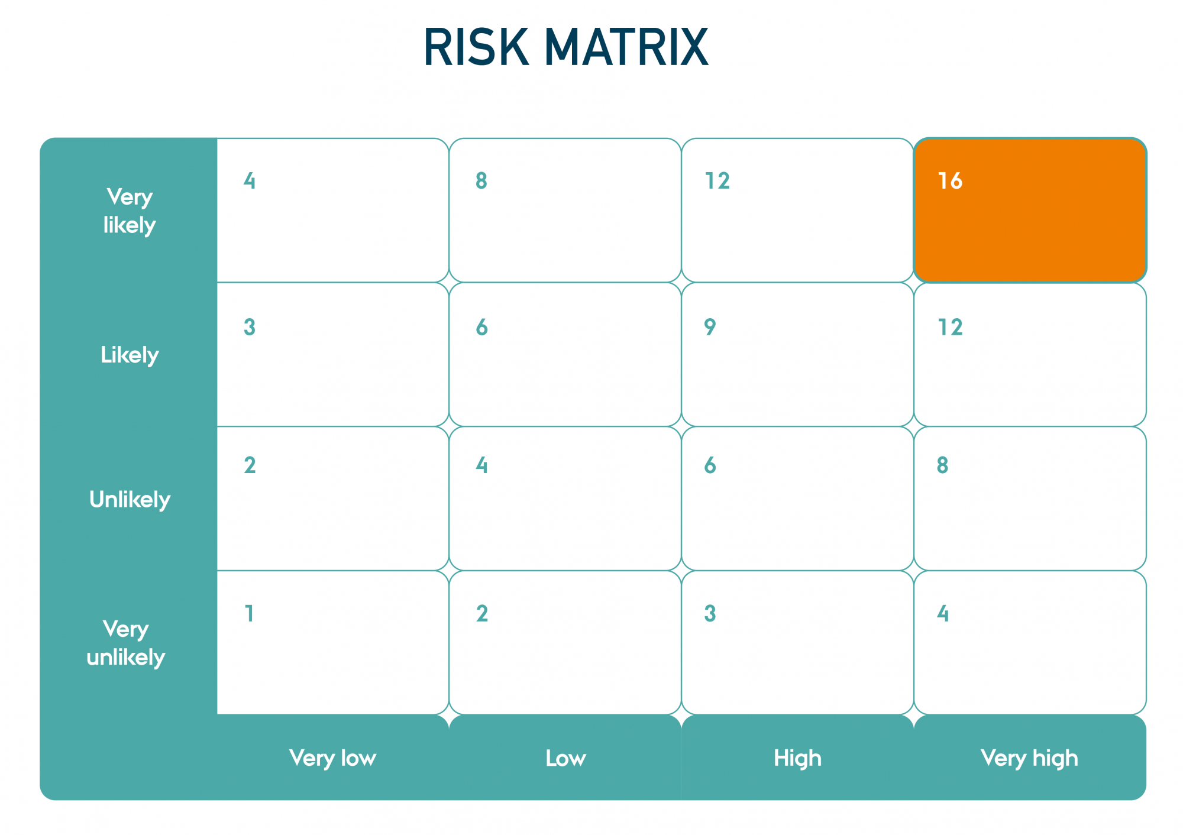
Risk Analysis / Threat Analysis
Likelihood – how likely it is that an attacker can exploit the threat​
Impact – what is the impact on the system if the threat to be exploit​
Risk = Likelihood x Impact​
During context establishment, we defined what those labels mean​
Likelihood “very low” could be defined as probability 0,01% or frequency “every 100 years”​
Consequences “high” could be defined as financial impact greater than 1MEUR or more than 20% customer base lost​
​

Slide 49
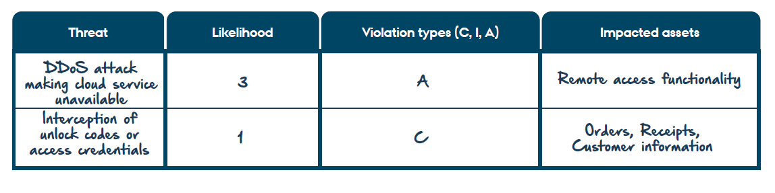
Threat Analysis – Example

Slide 50
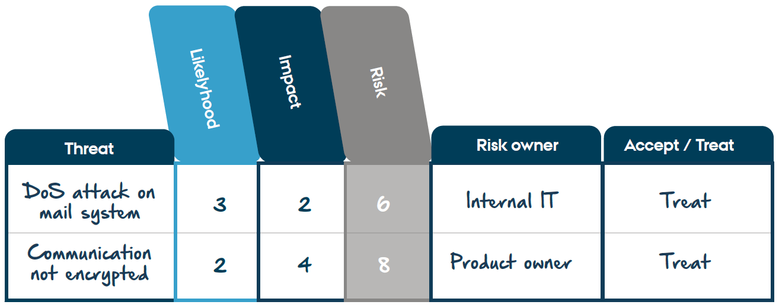
Combining the risk analysis

Slide 51
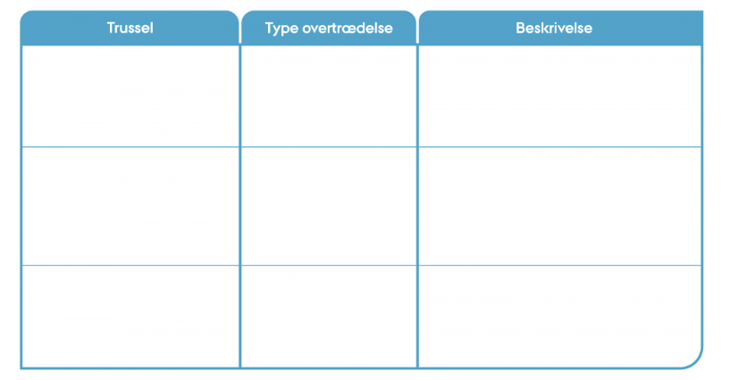
Task: Threat Identification​​
1) Look into components where data flows across trust boundaries and discuss where potential issues may arise when components/actors with different trust levels exchange data. This will uncover significant and critical threats.
2) Look into components where data flows within a trust boundary and discuss where potential threats may arise. It is not uncommon to have overlooked something or drawn an incorrect trust boundary. There may also be internal threats that should be taken into account.
3) You may also want to look into previously identified assets and consider if it is possible to:
gain unauthorised access to reading or manipulating the asset.
ensure that the asset is unavailable to interdependent components/actors.

Slide 52
Risk management
Communication and consultation
Context establishment
Monitoring and review
Risk assessment
Risk identification
System modelling
Asset identification
Threat identificaion
Threat modelling
Risk analysis
Risk evaluation
Risk treatment
Notes:
While ISO 27005 is our reference for Risk Assessment, in the slides we use this picture, where we bring focus to specific activities

Slide 53
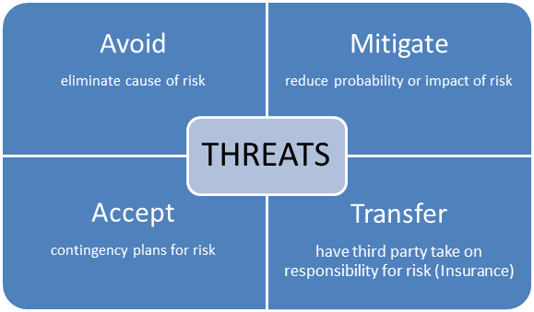
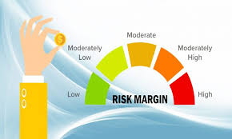
Risk evaluation and treatment
What needs to be improved and how?

Slide 54
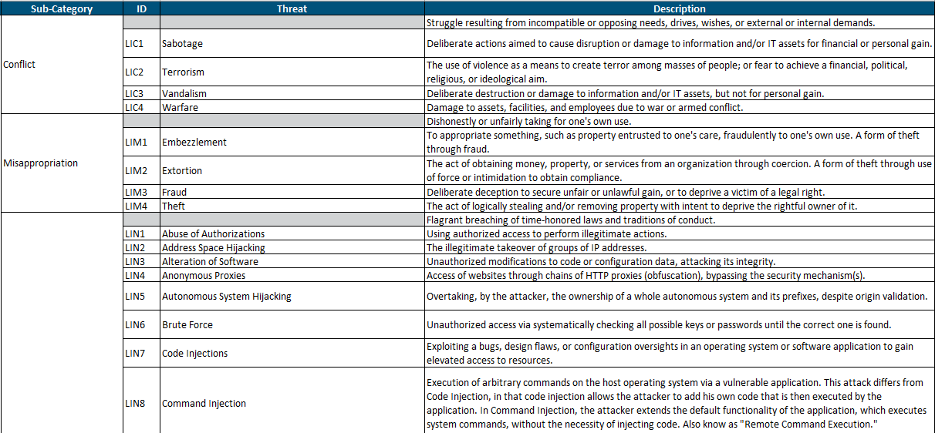
Challenges we see in practice
Threat catalogues(!)

Slide 55

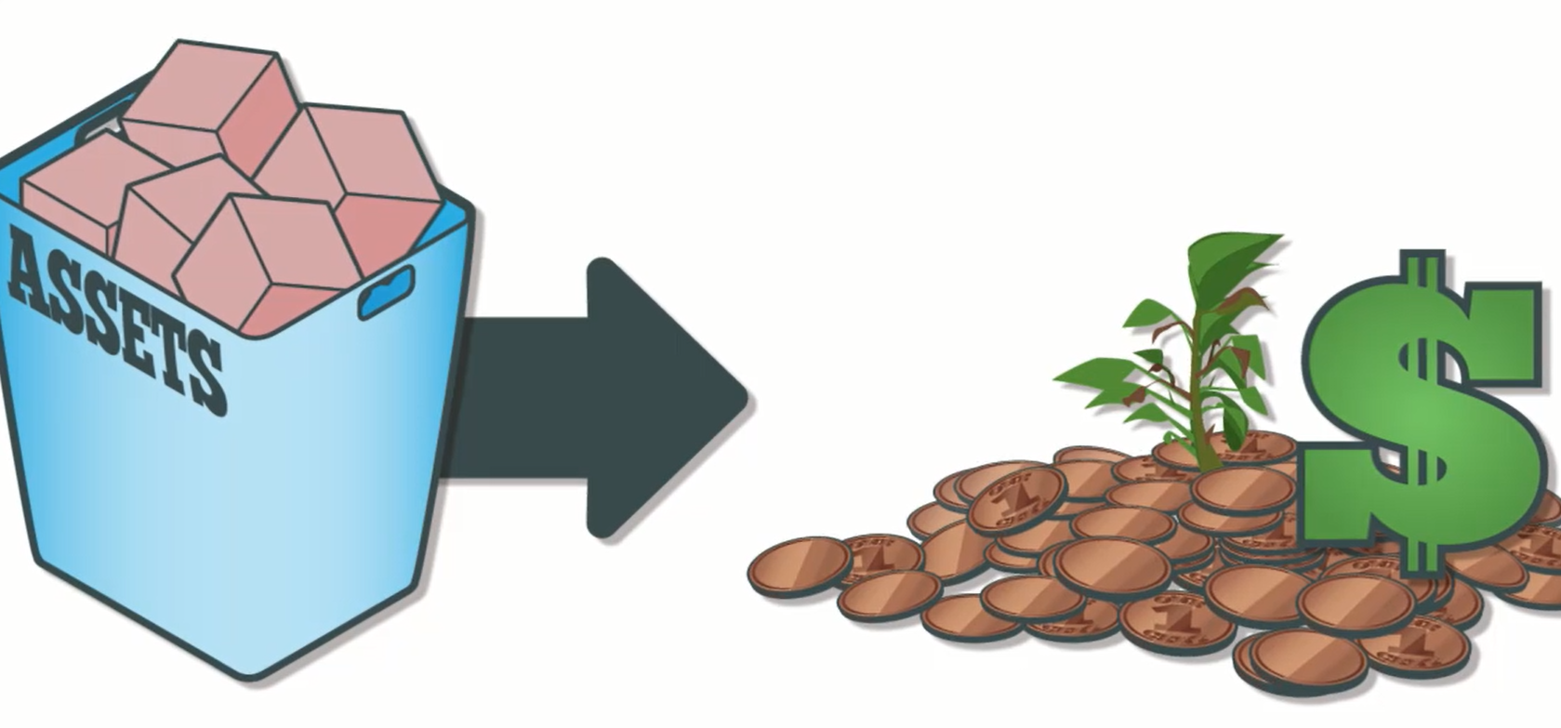
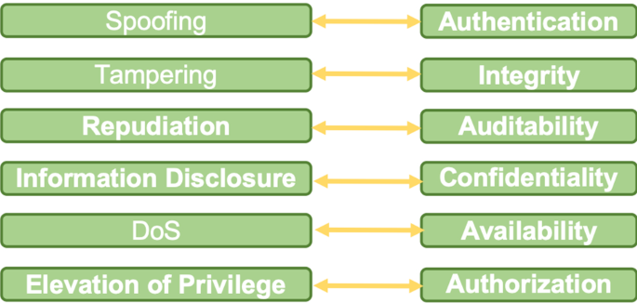
Challenges we see in practice
There are many (new) technical terms in litterature
Notes:
Hvad ser vi i praksis?

Slide 56
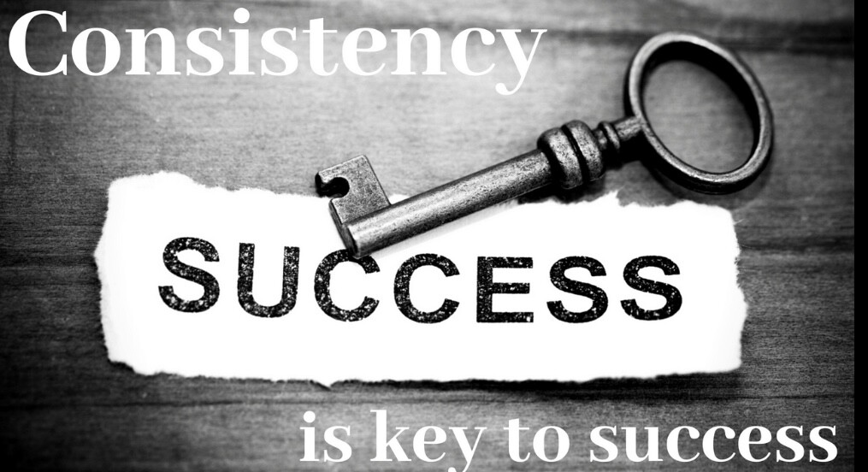

Slide 57
Break

Slide 58
Context establishment

Slide 59
Establishing the Context
Why to do risk management?
Are there special consideration?
What can we tolerate?

Slide 60
Risk: What and How
Risk = Likelihood x Consequence
Notes:
At the end of the day, any risk assessment method leads to compute risks as a function of likelihood, that is, probability for the threat to materialise, and consequence, that is, the impact of the threat
In this way, we can rank risks and make sure we focus on the most important risks first
Then, the next natural question is to wonder how to define and measure likelihood and consequences
Reasoning about the context can help define them for the specific case
Risk appetite, defined as the amount of risk an organization is willing to pursue or accept, can vary considerably from organization to organization. For instance, factors affecting an organization’s risk appetite include size, complexity and sector. Risk appetite should be set and regularly reviewed by top management.

Slide 61
Context Establishment - Example

Slide 62
Casen
I er ansvarlige for at udføre en risiko analyse på “Danish HEAT heating pumps”
Casen har bevist en række “huller”, som I kan udfylde og diskuttere konsekvensen af f.eks.
Hvilke systemer er driftet i en cloud løsning og hvilke er on-premise?
Hvordan er virksomheden struktureret ledelsesmæssigt?
Generelt frie rammer
Skal facilitere diskussion

Slide 63
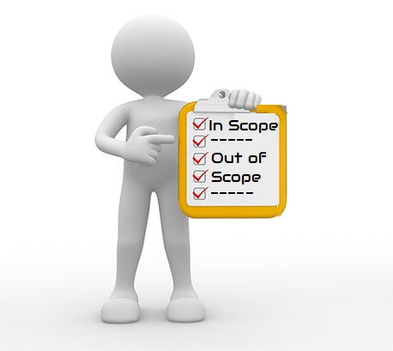
Task: Context establishment
Which system/product you want to assess?
Why to do a risk analysis?
Laws/rules? Requirement for customers?
Who should be involved in the process and how?
Internal and external stakeholders
Which parts of the process?
How to define risk assessment criteria, such as likelihood and consequences? What does “high”, “medium”, “low” or “no” risk mean to you?
How are the potential threat actors?

Slide 64
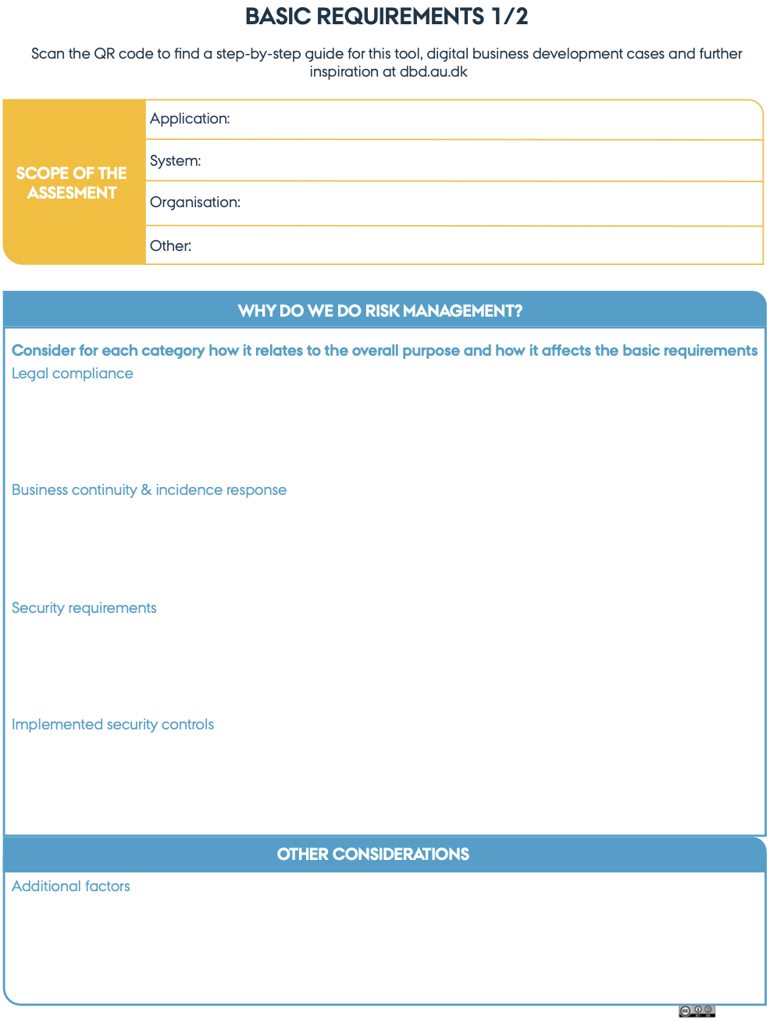
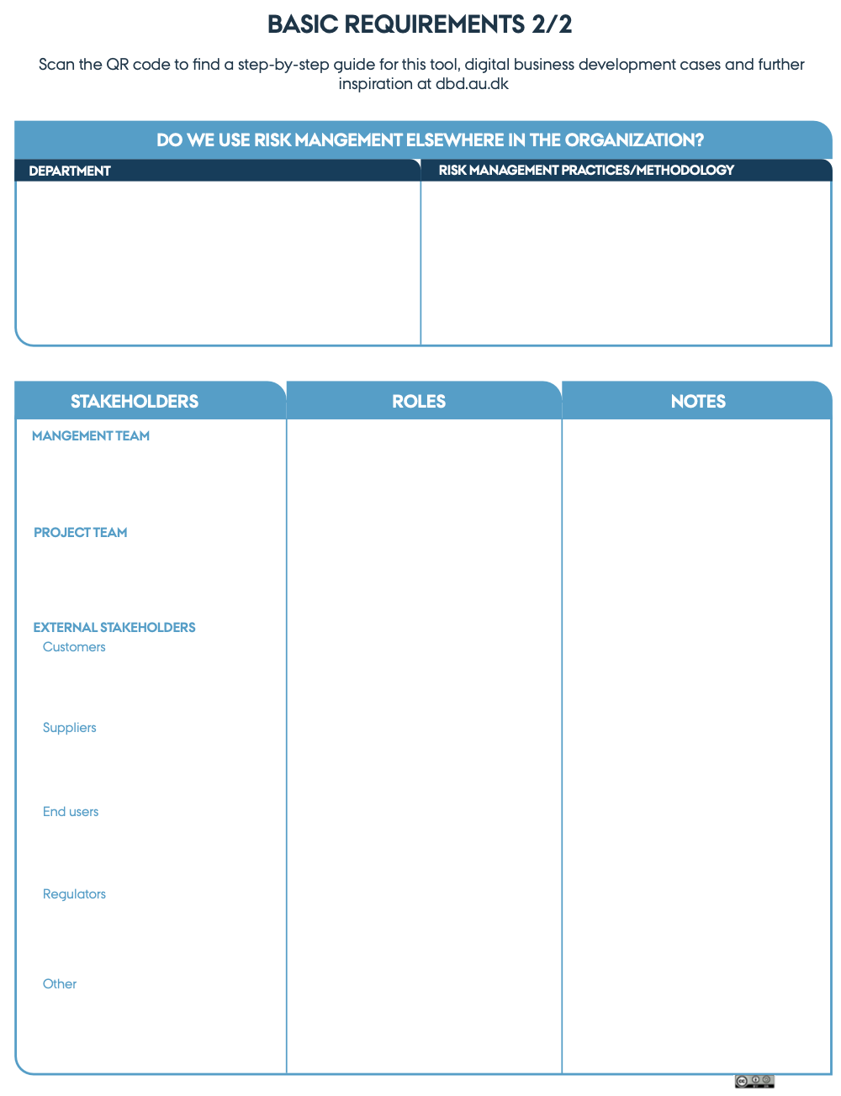
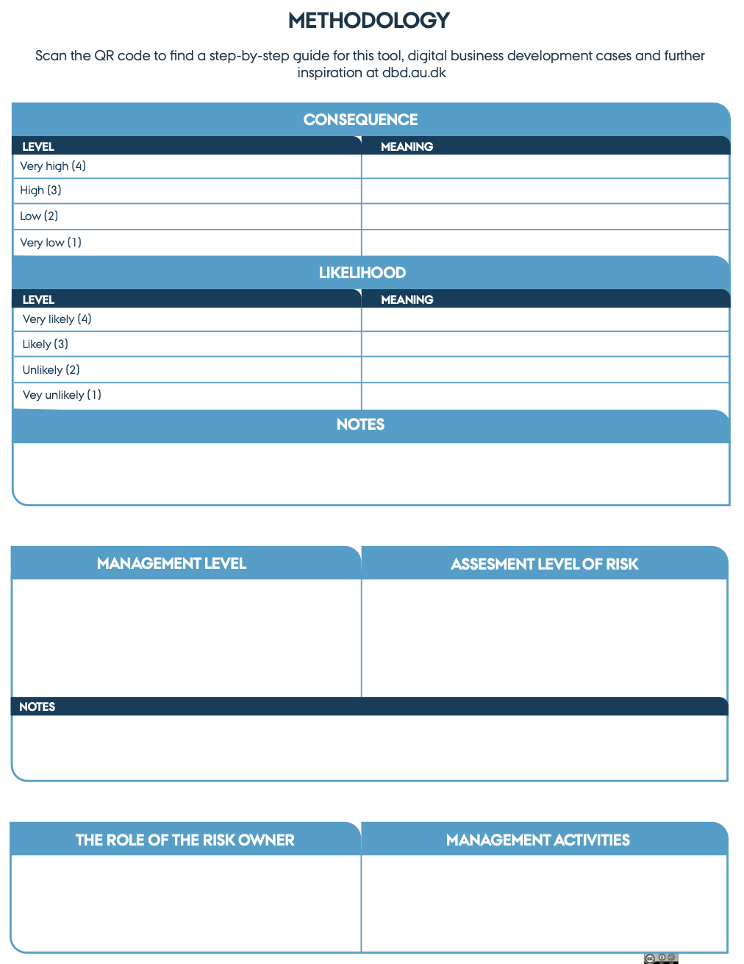
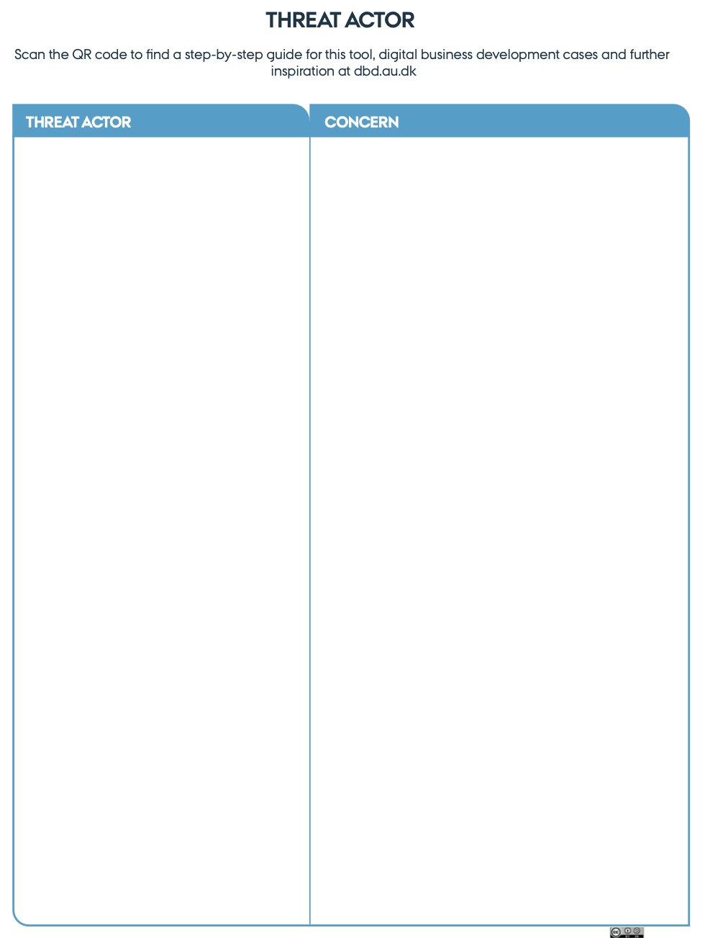


Task: Context establishment

Slide 65
System modelling

Slide 66
System Modelling
Overall goals:
Agree on which system is being evaluated
Identify the elements that form the system and their connections
Identify interactions between components
Understand how data flow across different components and data stores
Identify where a trust relationship between the components exists. Mark where the level of trust changes
What have we overlooked? Where does data come from and who uses data? How is the system managed? Backup and log systems?

Slide 67
System Modelling - Example
IoT doorlock
An IoT device allows you to lock and open a door via a cloud solution
A smartphone app can be used to control the lock
Smartphone user is logged in to a cloud solution
Cloud solution is used for user management
API / Interface to other systems (related to user management)

Slide 68
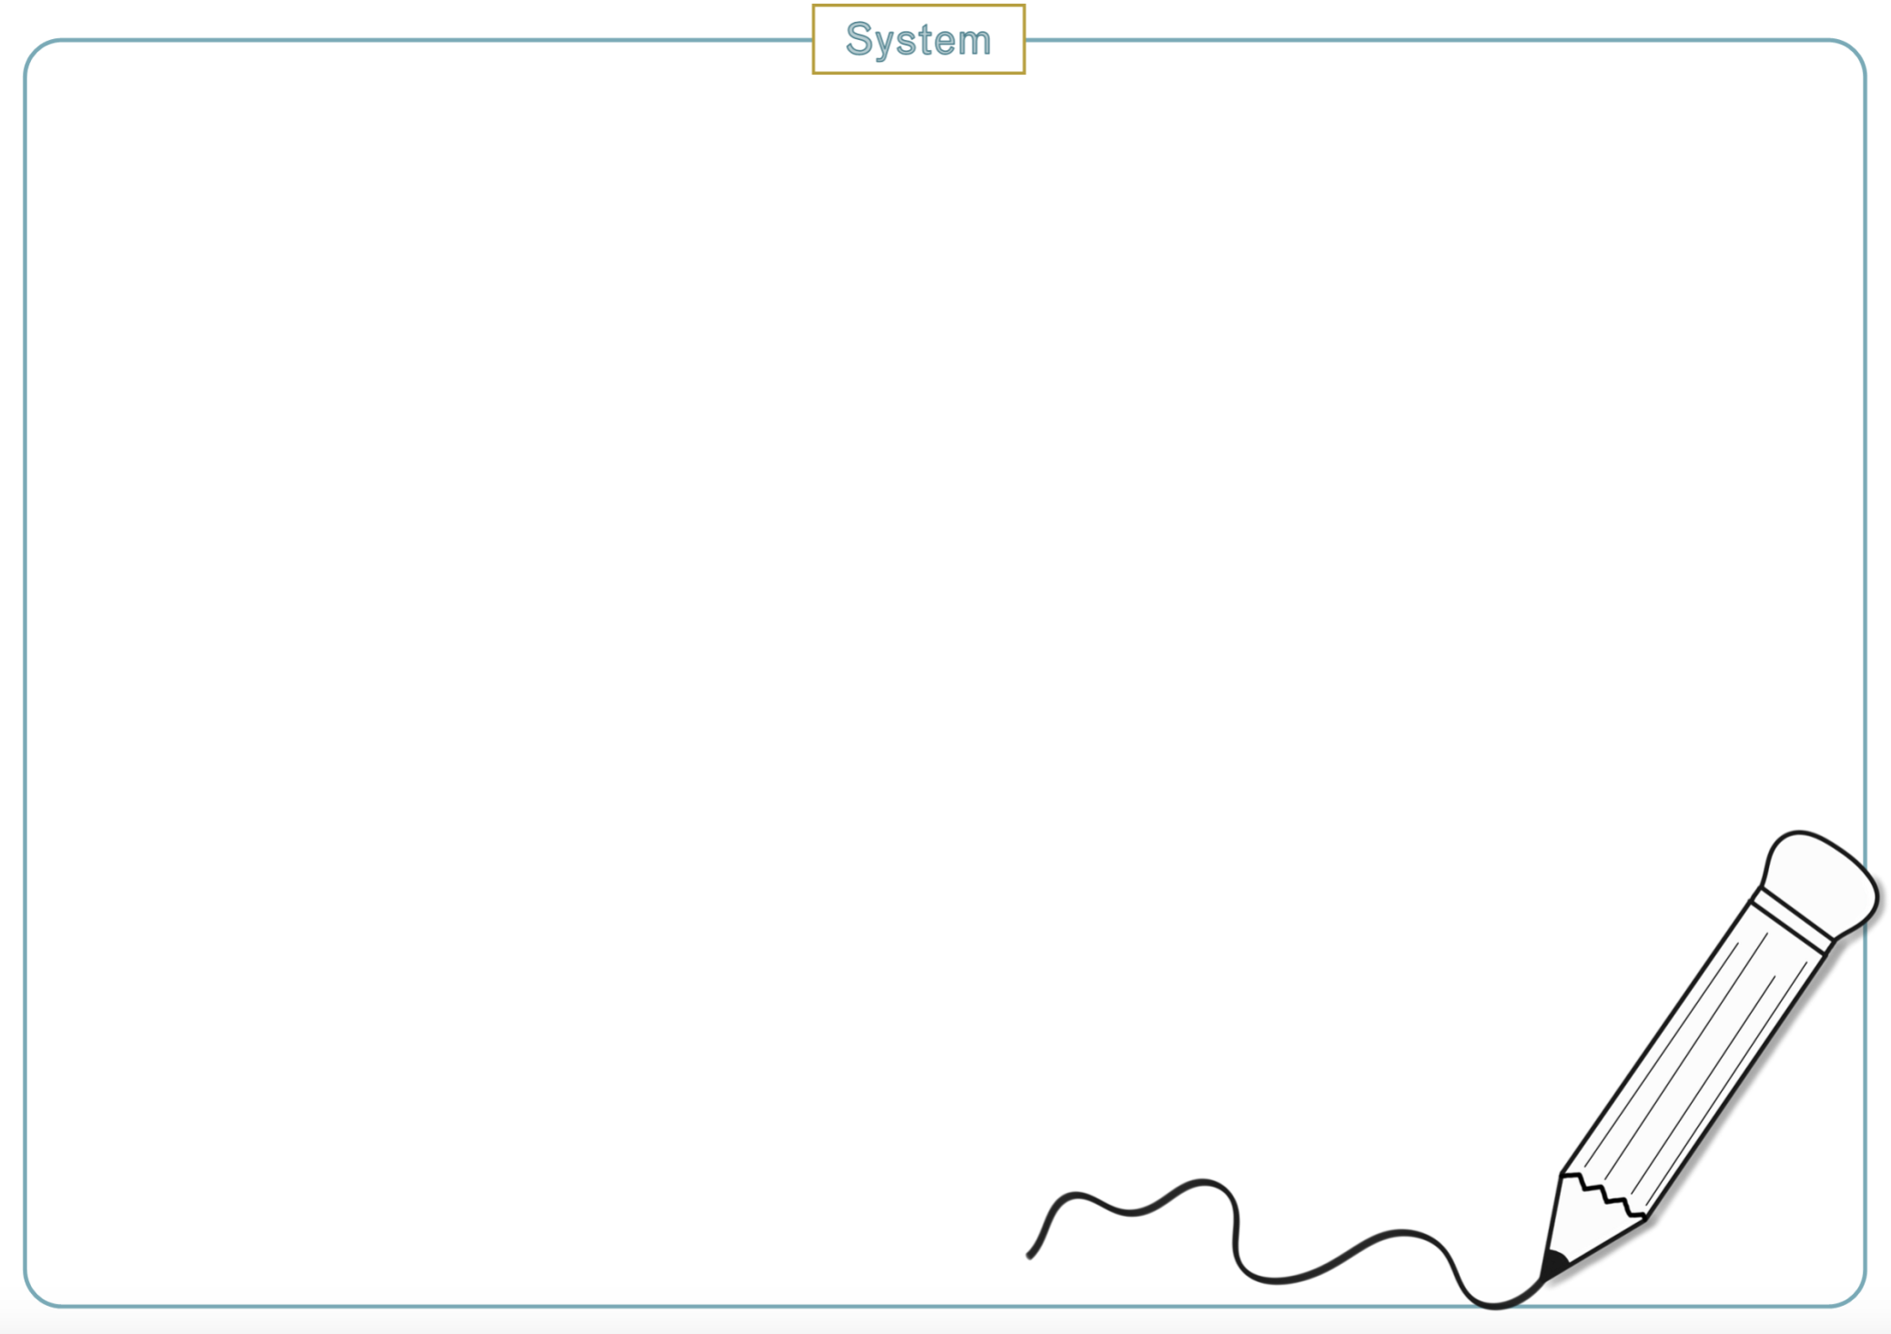
Task: Model your system
Identify the elements that form the system and their connections
Understand how data flow across different components and data stores
Mark where the level of trust changes
What have we overlooked? Where does data come from and who uses data? How is the system managed? Backup and log systems?

Slide 69
Lunch

Slide 70
Asset identification

Slide 71
Asset Identification
Take the system architecture as the starting point
Brainstorm: think abstract and broad
List of business assets
List of technical assets
Combine the two lists
Keep the list abstract (but save the technical descriptions)
Identify data that are important to operate your system and business
Notes:
You can let people with business understanding describe what data it is that the customers and other stakeholders get/want, what it will be used for and what is needed to create it. At the same time, you can let technicians look at what data is in the system. This concerns what is stored in databases/file systems, data retrieved from external partners, data sent to clients, etc. The two lists can then be merged into a single list.

Slide 72
Asset Identification - Example
Assets:
Lock/unlock commands
Access credentials - users (passwords, keys)
Access credentials - systems
User data (including users access control list)
Log data
Notes:
Lock/unlock commands - Machine instruction for a door to (un)lock
Access credentials – user : Passwords and keys, controlling user access to the system
Access Credentials – systems: Key material for integrating with other systems
User data - Information on users, including the users access control list (ie. What doors may the user (un)lock)
Log data - Logs of when a user (un)locks a door + access to the system + change of access rights

Slide 73
Task: Identify your assets
Identify data that are important to operate your system and business
Make one list, think both business-wise and technically
Is there anything on the system drawing that is not on the list and vica versa?

Slide 74
Asset Requirements

Slide 75
Asset Requirements
Overall goal: Assess how important the individual assets are (and why)
CIA
Confidentiality - data is kept confidential from unauthorized individuals
Integrity – data can only be modified by authorized individuals
Availability – data is available when needed
Asset requirements have a direct correlation to assessing threats on the asset itself
Notes:
Confidentiality - Should data be kept secret?
Integrity - What are the consequences of incorrect data?
Availability - Should data be available? How long can data be unavailable?

Slide 76
Asset Requirements – Example: Lock/unlock commands
Description: The command that causes the lock to lock or unlock. Send from the cloud solution, via IoT gateway to the lock.
CIA:
Confidentiality – Data can be used to conclude when a person is at home/left the building (in consumer market) (Score: 3)
Integrity – If data can be manipulated, the function of the lock can be affected (Score: 4)
Availability – If the commands can be blocked, the lock will not work (Score: 4)

Slide 77
Task: Asset requirements
CIA
Confidentiality - data is kept confidential from unauthorized individuals
Should data be kept secret?
Integrity - data can only be modified by authorized individuals
What are the consequences of incorrect data?
Availability - data is available when needed
Should data be available? How long can data be unavailable?

Slide 78
Risk management
Communication and consultation
Context establishment
Monitoring and review
Risk assessment
Risk identification
System modelling
Asset identification
Threat identificaion
Threat modelling
Risk analysis
Risk evaluation
Risk treatment
Notes:
While ISO 27005 is our reference for Risk Assessment, in the slides we use this picture, where we bring focus to specific activities

Slide 79
Threat Identification

Slide 80
Threat Identification – Example
Data flows across trust boundary: Shopper to shopping cart

Slide 81
Threat Identification
CIA triad
Confidentiality – data protected from unauthorised access
Can the access control mechanisms be bypassed?
Integrity – data accurate and consistent
Can malformed data be entered into the system?
Availability – data accessible and usable on authorised demand
Can a 3rd party issue affect your own availability?

Slide 82
Threat identification – Example

Slide 83
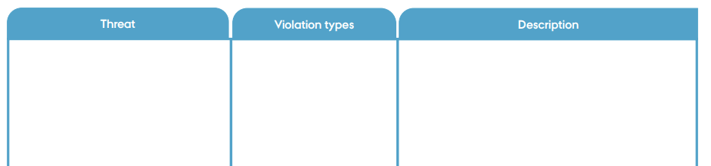
Task: Threat Identification
12

Slide 84
Threat and Risk Analysis

Slide 85
Risk Analysis / Threat Analysis
Likelihood – how likely it is that an attacker can exploit the threat​
Impact – what is the impact on the system if the threat to be exploit​
Risk = Likelihood x Impact​
During context establishment, we defined what those labels mean​
Likelihood “very low” could be defined as probability 0,01% or frequency “every 100 years”​
Consequences “high” could be defined as financial impact greater than 1MEUR or more than 20% customer base lost​
​

Slide 86
Task: Threat Analysis
4
12

Slide 87
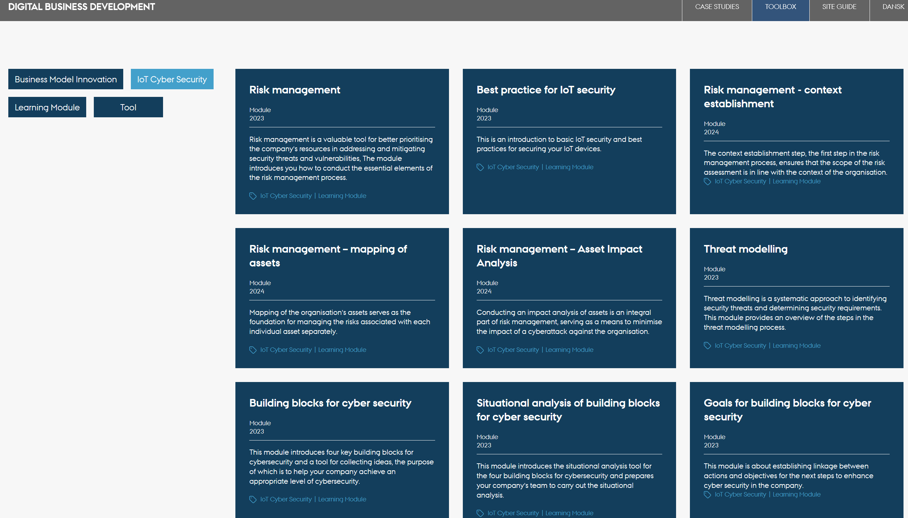
Digital Business Development https://dbd.au.dk/p/toolbox#iot-cyber-security

Slide 88
Digitale værktøjer og alternativer

Slide 89
OWASP Threat Dragon
Program til at tegne og annotere trusselsmodeller.
Projektside: https://owasp.org/www-project-threat-dragon/
Webapp: https://www.threatdragon.com/

Slide 90
Sikker Digital – IT-risikovurderingsværktøjet
Spørgeskema til at lave risikovurdering af små og mellemstore virksomheder.
Besvarelse resultere i en risikovurdering af virksomhedens aktiver i regnearks-format.
Tilgængeligt på sikkerdigital.dk
https://www.sikkerdigital.dk/virksomhed/test-og-vaerktoejer

Slide 91
cybersikker.alexandra.dk

